Slide 1
InstaPlow
An inflatable device that attaches to the rear of a car and enables the driver to push snow away as they exit the garage.

Slide 2
Agenda
My Background
Past Sponsorships
My Responsibilities
Types of Snow Plows
Concept of Operations – Scenario
Customer wants
Challenges
Requirements
Interfaces and other factors
Expertise Needed

Slide 3
My Background
BA (Psychology, Biology), URI, 1971.
MA (Engineering Psychology), NMSU, 1974.
Human Factors and System Engineer, Lockheed Martin, CA, 1974-2007
34 years experience designing missiles, ships, planes, spacecraft, command centers, mobile shelters, equipment racks and consoles, transportation systems, railcars, large facilities, support equipment, computer human interfaces.
Worked with design, system, manufacturing, training, logistics, parts, materials and processes, facility, field engineering.
Married 2008, returned to Rhode Island, home at 10 Queens River Drive – 5 miles from URI.

Slide 4
Sponsorship Track Record
HOME Shelter 2011 URI / RWU Capstone Project
Won 1st place Poster Session in 2011 American Society for Engineering Education (Northeast Section); 3rd place overall in undergraduate division
HOME Shelter 2012 URI Honors Class
URI – 16 students – 4 teams.
CircuiTree 2014 RWU Senior Project
Won 2nd place Open Task NMSU IEE WERC Contest
Won IEE WERC Peer Award
Provisional patent application considered.

Slide 5
What I do as a Sponsor
Review some system engineering approaches to requirements and design considerations.
Develop preliminary system requirements.
Review system requirements with team.
Attend team meetings.
Review reports.
Offer advice on system engineering analytic tools, methods, metrics, etc.
Conduct reviews
Requirements, concept, and design

Slide 6
The Project
A flexible inflatable device that can move snow when it is attached to a passenger automobile.

Slide 7
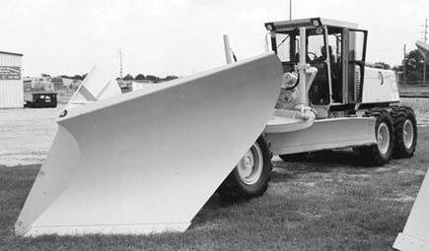
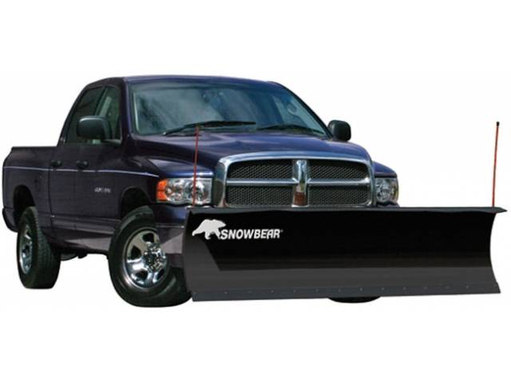
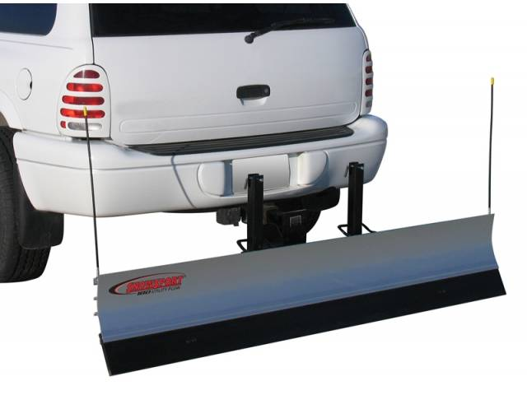
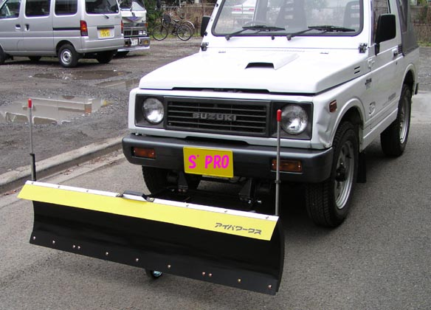
Types of snow plows
Heavy duty commercial plows
Light duty residential plows
All-terrain plows
Manual plows
Electric plows
Hydraulic plows
V-plows
Box plows

Slide 8
Current Characteristics of Snow Plows
Smallest homeowner model costs about $1,100.
Largest homeowner model costs about $5,000.
Use life 5-20 years.
Weigh from 50 to 2000 lbs.
Rigid construction
Require designated storage area
Usually large scrappers constructed of metal and rubber.
Some with electric or hydraulic capability.
No snow plow offered as a ‘single use’ emergency device for passenger cars.

Slide 9
CONOPS Scenario
Overnight snow fall.
Light snow of 1-2 feet.
Your car parked in your garage facing the wall.
No trailer hitch attached to passenger car frame.
50 feet to the road which is plowed.
Little time to shovel.
Limited physical capability to shovel.
What do you do?

Slide 10
What the customer wants…
Design an ‘easy-to-use’, ‘light weight’ snow plow…
that ‘attaches’ to the rear of a car…
without using ‘unapproved tools’…
by one ‘person’…
under ‘stressful’ conditions…
in ‘a short period’ of time…
that’s ‘cheap’.

Slide 11
Requirements Translated
What customer wants | Translated into a requirement
Light weight | Less than 10 lbs.
Attaches easily | Attached by one person using both hands
Doesn’t require special tools | Only tools in kit, if provided
Even a small person can use it | One 5th percentile female
Doesn’t stress me | Maintains normal heart rate
Takes a few minutes to install | Less than 10 minutes
Cheap | Less than $99
Easy to set up | Rolls up or rolls out
I can do it in my garage | Setup in a 7 ft. wide X 3 ft. deep space
Easy to inflate | Assisted with foot or electric pump
Make it safe | System Safety Hazard Analysis

Slide 12
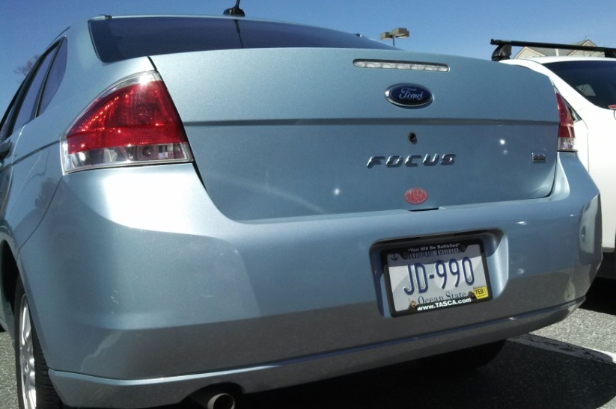
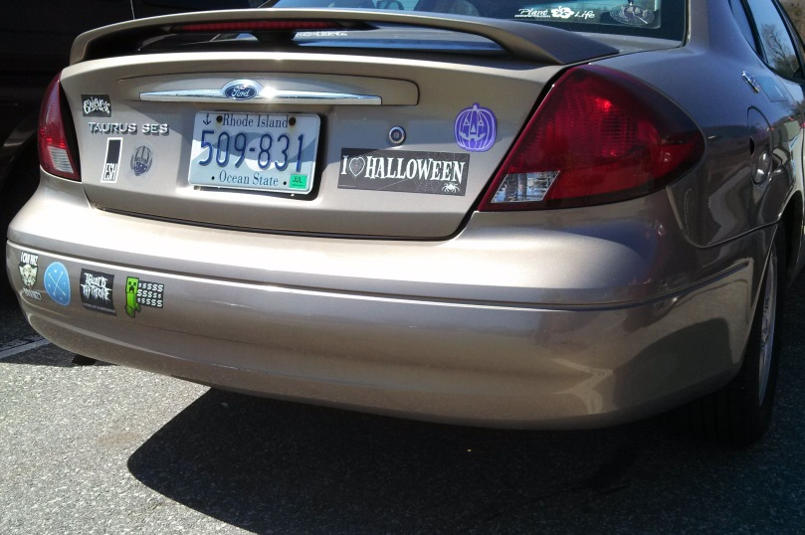
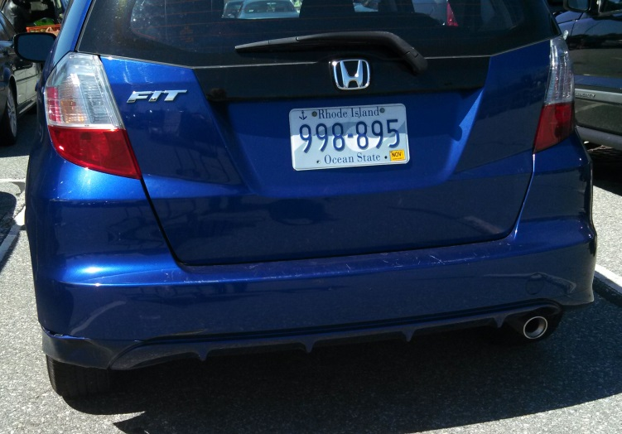
Interfaces – What do you see?
Originator: Rick Davids, human factors engineer, 831-359-6851, rcdavids1@verizon.net

Slide 13
Interfaces and Interferences
At least three possible interfaces:
Left and right wheel wells
To attach adjustable straps with padded cleat
The trunk lid / trunk tray interface
Could trap thick fabric straps 1 ft. wide either side of latch
Design a pillow bumper inside trunk to distribute load
Bumper
Moderate amount of force can be applied
Possible interferences
Exhaust pipes
Left, right or center
Single or dual exhaust pipes

Slide 14
Notional Design
Wedge shaped; 30 inches high
Plan View
Rear bumper
Retainer sack
Inflated bag
Electronic device
Strain gauge
Dual straps
Ribbon cable
Wheel well strap
Electronic device sounds alarm if strain exceeds limit or with forward motion.

Slide 15
Notional Design
Wedge shaped; 30 inches high
Side view
Trunk lid
Retainer sack
Wide strap with ribbon cable
Power and electronics
Inflated bag
Strain gauges
Wheel
well
Strap with cleat
Wiring
Attached and inflated in less than 10 minutes

Slide 16
Design Factors to Consider
Height of trunk lid to ground surface.
Distance from wheel well to aft car.
Location of exhaust pipes.
Contour of bumpers.
Bumper material.
Air bag deployment load (impact vs. gradient load)
Reverse speed range.
Durability of material.
Inflation mechanism, rate and volume.
Adjustability is important!

Slide 17
Other Factors to Consider
When to inflate.
Shape of device after inflation.
Weight of device.
Possible snow loads.
Interface with pavement, ground, gravel
Fabric stress points
Failure Mode and Effect Analysis (FMEA)
Personnel and System Safety Hazards
There are many variables and tradeoffs to consider!

Slide 18
Expertise Needed
Electrical Engineering Major
Strain gauge mechanism
Motion detection
Sensor and alarms
Hazard and FMEA
Mechanical Engineering Major
Stress and load analysis
Solidworks Modeling
Mechanisms
Hazard and FMEA
Engineering / Business Major
Business Plan
Provisional patent application
Engineering / Materials Major
Fabric strength, interfaces, surfaces treatments

Slide 19
Contacts
Joanne Bagley, President, Kenyon Industries, 401-364-3400. Kenyon Industries, Inc. is the country’s leading finisher of high quality woven synthetic fabrics. At Kenyon’s 300,000 sq. ft. manufacturing plant, 325 employees provide quality finishing services for fabrics used in a variety of markets. These include: luggage and knapsack, flag and banner, apparel, industrial, military, and the sailcloth market, where we remain the world’s largest processor.
Ms. Bagley volunteered to provide technical expertise regarding woven fabric manufacturing, finishes and technology. Email correspondence 29 April 2014. jbagley@kenyonindustries.net

